Slide 1
4th International SME Conference
2017.02.28
Maribel Ferreira
Manuel Brito
Lisbon City Council | General Direction for Economy and Innovation
Notes:
Strategic Goals
AMBITION & LEADERSHIP
Clear ambition and strategic direction to promote Lisbon as a hub of innovation, entrepreneurship and creativity on an international scale.
NET W ORKS & C ONNECTIVIT Y
Digital and physical interconnection o f actors and partners, stimulating the creation o f ecosystems o f innovation and
entrepreneurship.
OPENNESS & FA CILITATION
Openness to new ideas, c oncepts, experiences and businesses. View the city o f Lisbon as a Living Lab.
GLOBAL & LOCAL
Positioning Lisbon as an international business and innovation c enter, and simultaneously develop projects and initiatives with local impact.
AT TRA CTION & RE CEPTION
Create conditions for hosting and accelerating companies and new businesses with high potential f or growth and job creation.
C O - CREATION & PARTICIPATION
Project design and implementation involving public authorities, companies, universities, non-profit organizations and citizens.

Slide 2
Lisbon: Four Engines of Growth
ATLANTIC BUSINESS HUB
STARTUP CITY
JOBS
& EMPLOYABILITY
KNOWLEDGE & INNOVATION
STRATEGIC CLUSTERS
Notes:
Lisbon: Four Engines of Growth
1. “LISBON: ATLANTIC BUSINESS HUB”
One of the basic assumptions of this strategy is the strong conviction that Lisbon should cooperate and compete on a global scale. The geostrategic location of Lisbon as an “ATLANTIC HUB” and a number of important key factors of competitiveness, place this capital city in a unique position to attract investments, businesses and talent.
To achieve these objectives it´s essential to develop actionable projects and initiatives that will turn this will into concrete results.
If the international positioning of Lisbon in attracting and retaining businesses and investments is important, it’s also important to create the conditions so that anyone can start and/ or expand its business or company in Lisbon. This is the work done since 2009 by INICIATIVA LISBOA, which aims to simplify and centralize the process of installation and operation of businesses and economic activity in the city. This one-stop shop allows applications and processes to be delivered in a single point of contact, combined in a single process and treated by a single manager.
2. ”LISBON: KNOWLEDGE AND INNOVATION”
Lisbon is a truly University City and the most important higher education region of Portugal. Lisbon has almost 100 institutions of higher education, more than 130,000 students/year in universities, nearly 40,000 graduated/year and more than 15,000 researchers. With these key assets, Lisbon City Council has been working intensively with all relevant institutions of the city, to strengthen its R&D and innovation system on an international scale and integrate it in this economic development strategy.
The project “STUDY IN LISBON” (www.studyinlisbon.pt) illustrates this position and ambition. Involving a partnership with all universities and research centers, and other institutions that support students and researchers. This project is based on a web platform that provides a set of information and services with the core objective of attracting and retaining talent, making Lisbon a global center in the areas of knowledge and innovation. In January 2017, Lisbon City Council will open the Study in Lisbon Lounge, a focal point to help all the international students to settle in the city.
3. ”LISBON: STRATEGIC CLUSTERS”
We strongly believe that the STRATEGIC CLUSTERS are an efficient instrument to concentrate resources and investment and federate stakeholders around structural projects, which, for its innovative nature and the ability to create value and jobs can contribute significantly to expand and strengthen the economy of Lisbon.
The approach to the strategic clusters of Lisbon is based on a common methodology which has as its starting point an assessment of the economic value and employment in sectors with high potential for future growth in the city and the mapping of the strategic actors in each of these clusters. The basic assumption of this work around Strategic Clusters is the involvement and active participation of partners in the development, validation and discussion of programs and initiatives to be implemented in each sector.
This economic policy based on the development of Strategic Clusters currently includes the following sectors: Creative Economy; Health and Wellbeing; Sea Economy; Digital Economy and the strong effort to transform Lisbon in a Smart City.
These four strategic clusters complement the more consolidated sectors and activities which have a greater weight in the specialization profile of the city’s economy, such as Tourism, Commerce & Trade, and Financial and Professional Services and the Real Estate value chain
4.”LISBON: STARTUP CITY”
The second driver of this strategy aims to transform Lisbon in a GLOBAL STARTUP CITY and create the conditions for more people to create and expand their companies and businesses in the Portuguese capital. Lisbon was recently elected by the Committee of the Regions as “European Entrepreneurial Region 2015”, award that was for the first time given to a European city and recognizes the strategy that has been developed by Lisbon in the fields of entrepreneurship and support to SMEs and self-employment. More recently, Lisbon was the city chosen to host from 2016 to 2018 the WEB SUMMIT - Europe’s largest and most important technology Conference and Marketplace.
The starting point for this strategy was the creation of STARTUP LISBOA (www.startuplisboa.pt) the city incubator for businesses that currently has three spaces of incubation and a residence for entrepreneurs. From 2011 Lisbon began to stimulate an entrepreneurial ecosystem, which currently has 18 incubators and accelerators, housing more than 475 startups and 3.000 jobs, 5 FabLabs, about +40 coworking spaces and a strong community of Business Angels and Venture Capital investors. In November 2016 it was launched MADE OF LISBOA - The new digital platform of all the Lisbon-based Innovators (www.madeoflisboa.com).
It should be stressed that the strategy that has been developed in the field of entrepreneurship aims to meet different people and needs, and that was the reason why it was created the micro entrepreneurship program – LISBOA EMPREEENDE - directed to small businesses, the Youth Entrepreneurship Program which in 2015/16 involved more than 60 schools and 8,000 children and young students from the city or the DELI project directed to the migrant entrepreneurs.

Slide 3
Notes:
Lisbon was claimed the European Entrepreneurial Region in 2015. The Committee of the Regions in partnership with the European Commission reward regions with outstanding forward-looking entrepreneurial visions that are realised through concrete and measurable actions contributing to the implementation of the Small Business Act for Europe and making optimal use of public funding, irrespective of their size, wealth and competences.

Slide 4
LISBON
ATLANTIC BUSINESS HUB
Notes:
About the first engine and in a brief way : Lisbon Atlantic Business Hub

Slide 5
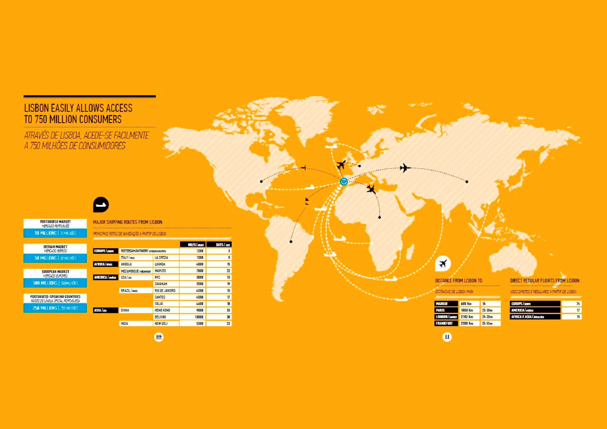
Notes:
Lisbon: Atlantic Business Hub
Investment: LISBON is increasingly an attractive city for Multinational Companies (MNCs), but also the lanchpad for the expansion of Portuguese and International companies.
Lisbon has been able to attract a growing number of companies, investments and talent, something that results from structural factors but also from the strategy that has been followed to put Lisbon on the map of the international competition.
Lisbon has very strong and multiple reasons to invest, especially its privileged geostrategic situation as an European Atlantic Hub with access to 500 million European consumers, benefiting from the advantage of maintaining unique relations with Portuguese-speaking countries, representing a market of 250 million people.
Lisbon, It’s the economic center of a 2,8 million people metropolitan region, has high qualified human resources, a cosmopolitan environment and high quality of life. On the other hand, Lisbon is a city with sustainability concerns, highly creative and entrepreneurial, and also one of the safest cities in Europe.

Slide 6
LISBON
KNOWLEDGE AND INNOVATION
Notes:
About the second engine and in a concise form: Lisbon Knowledge and Innovation

Slide 7
Notes:
Lisbon is the largest University and Research Hub of Portugal, with about 134,000 students enrolled in higher education, more than 15,000 researchers, receiving more than 13,000 international students annually and more than 3,000 students under the Erasmus program.
Following the plan to strengthen the position of Lisbon as a center of knowledge and make it a true Erasmus city, the City Council launched the platform STUDY IN LISBON (www. studyinlisbon.pt), which wants to be an aggregator platform for information, partners and initiatives, and has as main objective to attract and retain talent (students and national and foreign researchers) positioning Lisbon internationally as a global hub in the fields of knowledge and innovation.

Slide 8
STRATEGIC CLUSTERS
Notes:
About the third engine and again in a short way: Strategic Clusters

Slide 9
Lisbon: Strategic Clusters
BLUE ECONOMY
CREATIVE ECONOMY
GREEN ECONOMY
DIGITAL ECONOMY (ICT, WEB)
HEALTH & WELL BEING
COMMERCE
CONSTRUCTION & REAL STATE
TOURISM
FINANCIAL SERVICES
SMART CITY
URBAN RESILIENCE
KNOWLEDGE & INNOVATION
ENTREPRENEURSHIP
Notes:
We in the Lisbon City Council strongly believe that Ecosystems and Clusters are important strategic platforms and efficient instruments for the development of Lisbon economy.
We want that the strategic clusters of Lisbon to consolidate and renew continuously, ensuring the dissemination/ transfer of knowledge and know-how.
The starting point for the approach to the strategic sectors in Lisbon is based on a common methodology that includes indicators and the mapping of its major actors. The strategic partners actively participate in the development, validation and discussion of the programmes and initiatives for each sector.

Slide 10
LISBON
STARTUP CITY
Notes:
About the fourth engine: Lisbon Startup City, the one we are going to present you with a bit more detailed.

Slide 11
Notes:
Lisbon has been competing with some other European capitals for the most renowned technological events, with notorious success. The best recent example was the hosting of the Web Summit last year, an event that gathered almost 60.000 attendees, from 166 countries, 1490 startups from around the world, 1300 investors, 677 speakers were there. This event implied 650 Mentor´s hour sessions and 37 thousand Kilometres of optic fiber cable (equall to climb Mount Everest 4 times). Moreover, It is agreed to stay in Lisbon for the next years (at least for 2017 and 2018).

Slide 12
Notes:
The Lisbon City Council has been developing and supporting a very diverse range of projects and initiatives in the fields of entrepreneurship, inovation and creativity, with a strong focus in the areas of incubation and acceleration of startups, support to SMEs and self-employment.
One of the newest most ambitious and innovative projects is Made Of Lisboa - the brand of Lisbon Entrepreneurial Ecosystem.
Made of Lisboa it’s the new digital platform of the Entrepreneurial and Innovation Ecosystem of Lisbon. A place to get you updated about Lisbon’s innovation scene and the one and only official community of Lisbon-based innovators.
The platform has four major objectives: INFORM. CONNECT. ATTRACT. ORGANIZE

Slide 13
ANALYTICS
Ecosystem Numbers
18
INCUBATORS
& ACCELERATORS
05
FABLABS / MAKERS SPACES
+40
COWORKING SPACES
4.750
TOTAL COMPANIES
CREATED IN LISBON
(2015)
+180
INVESTMENT (RAISED BY STARTUPS)
(MILLIONS)
475
STARTUPS IN INCUBATORS
(2016)
3.164
JOBS IN INCUBATORS
& ALUMNI
(2016)
1.348
STARTUPS IN INCUBATORS & ALUMNI
(2014 - 2016)
5.730
JOBS IN INCUBATORS
& ALUMNI
(2014 - 2016)
700
COMPANIES CREATED IN HIGH TECH SECTORS (LISBON, 2014 - 2016)
Notes:
The goal is to outline and map the ecosystem and give you not only the power to see what the ecosystem is made of but also the power to shape it through our tools. These are some of the numbers of Lisbon´s Ecosystem.

Slide 14
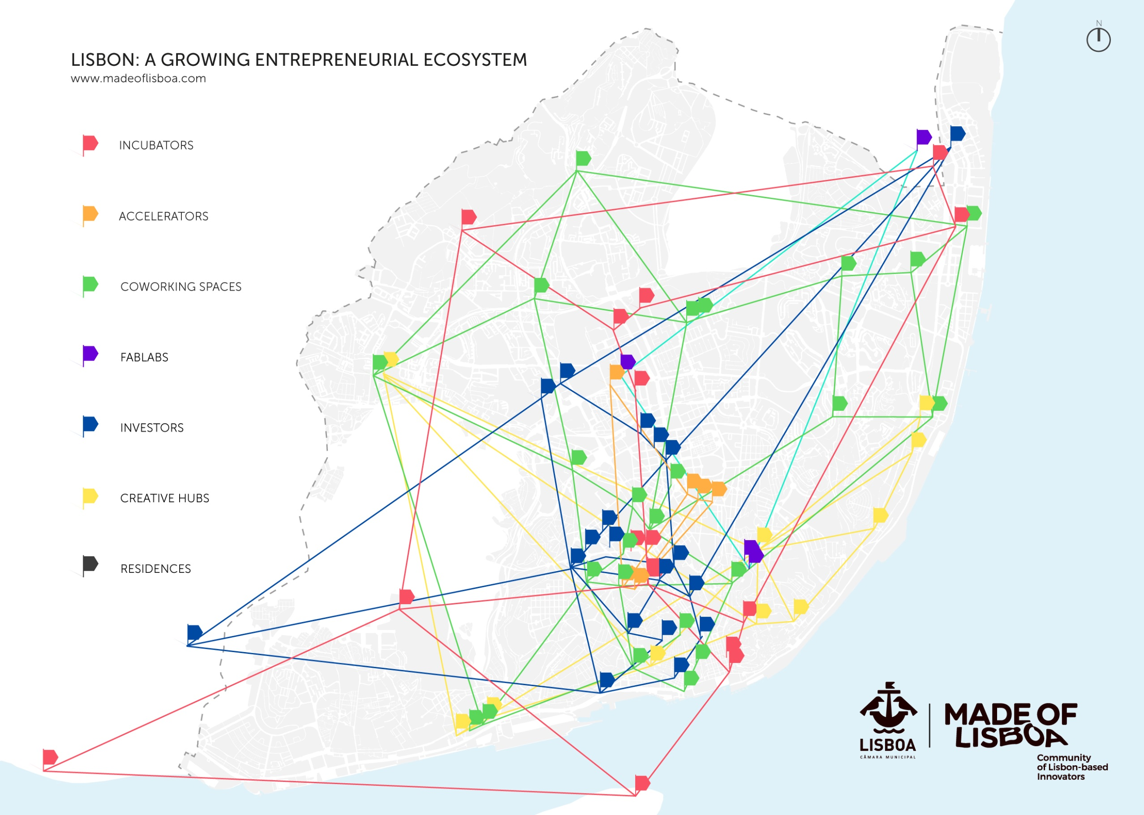
Notes:
This map gives you the idea of the sort and location of Lisbon´s Ecosystem

Slide 15
Lisbon: Startup City
LISBOA EMPREENDE - Micro-Entrepreneurship
Applications | Projects / Companies Supported | Projects / Companies Installed | Projects / Companies Financed | Jobs Created
1.310 | 350 | 86 | 46 | 195
(Nº) | (Nº) | (Nº) | (Nº) | (Nº)
Notes:
As part of this enabling enviroment appears Lisbon Micro-Entrepreneurship program that we represent and are here to talk about.
The Lisbon Micro-Entrepreneurship program, launched on February 2013, is part of the Lisbon City Council strategy for entrepreneurship and aims to meet the needs of entrepreneurs who want to develop small businesses but have difficulties to access investment.
This program aims to boost the city’s economy, supporting people to create their businesses.
This programme is directed primarily to boost businesses in the commerce and services sectors in the city of Lisbon, and aims to establish itself as a response to the limitations of the traditional labor market through an approach based on self- employment.

Slide 16
Lisbon: Startup City
LISBOA EMPREENDE - Micro-Entrepreneurship
Major Partners
CASES | Montepio Geral | Millenium BCP | BPI | CGD | NOVO BANCO| ANDC | Cooperativa João Sem Medo | IEFP
Other partners in the Network
Startup Lisboa Tech e Startup Lisboa Commerce | Invest Lisboa | UACS | Beta i | Labs Lisboa | CIM| EGEAC
Notes:
Lisbon Micro- Entrepreneurship is an inclusive program targeted to support new companies and SMEs, providing free consulting services and access to microcredit instruments.
The idea is to use the institutional power of the municipality to celebrate partnerships with public institutions (as CASES, IEFP, ANDC...) and private entities (as Banks) that permits access to financing with very special rates and conditions.
The aim is to facilitate access to funding, boost entrepreneurship and the local economy and create jobs

Slide 17
Lisbon: Startup City
LISBON MICRO-ENTREPRENEURSHIP
Free consultancy services
Advise on how to obtain finanting
Integration in the local entrepreneurial ecosystem
Notes:
It is a wide open program and entirely for free. Anyone from any place can apply, it includes entrepreneurs from all over the world. The only condition is that the business has to be settled in Lisbon.
Lisbon Micro-Entrepreneurship´s work is divided in 3 main sectors:
Consulting to the business idea, the concept of the project, business plan, and so on. Coaching through the whole process of the project development. This sometimes includes mentoring after the business is already set up;
Access to Financing The fact of LCC has partnerships with financial institutions makes access to financing easier for our entrepreneurs.
Besides that the Municipality has also other financing projects as Crowdfunding Lisboa and Startup Loans (up to 45,000 euros), targeted to facilitate funding to those who have valid projects for the City;
Access to Lisbon Entrepreneurship´s Network that is an interesting ecosystem with a wide range of opportunities (co-working spaces, business incubators and accelators, FabLabs, as shown before in the map about de entrepreneurial ecosystem

Slide 18
Lisbon: Startup City
LISBOA EMPREENDE - Micro-Entrepreneurship
Some Figures
75% 30< age <50 years old
80% Unemployed
55% Women
64% High Education Qualifications
15% Foreigners
Notes:
The main clients of Lisbon Micro-Entrepreneurship are unemployed but skillful people (mostly people with college degrees and working experience), with ages between 30 and 50 years old.

Slide 19
Lisbon: Startup City
LISBOA EMPREENDE - Micro-Entrepreneurship
Notes:
Here you can see some of the entrepreneurs supported by Lisbon Micro-Entrepreneurship (holding na item representative of their business).

Slide 20
European Commission
European
Enterprise Promotion
Awards 2015
Grand Jury Prize
A special prize awarded to the entrepreneurial initiative considered the most creative and inspiring in Europe.
Winner
Lisbon Micro-Entrepreneurship
Lisbon Municipal Council, Portugal
Notes:
The program received the Grand Jury Prize of the “European Enterprise Promotion Awards” in 2015, the most important award given by the European Commission.
It was considered a creative and inspiring program by the European Commission and awarded as a good public practice in the area of business promotion and support to SMEs.

Slide 21
See You in Lisbon
Startup City
Lisbon City Council/Economy &Innovation
www.cm-lisboa.pt/en/business
Lisboa Empreende
www.cm-lisboa.pt/en/business/entrepreneurship/lisboa-empreende
lisboaempreende@cm-lisboa.pt
Link/Facebook
www.facebook.com/Lisboa-Empreende

